Slide 1
Introducing the Supermarket Billing System
{
Name: Al Nimra Kabir
Roll: 2008042
}
...

Slide 2
Introduction
This project designed to manage a supermarket buying and billing system. It allows both administrative and buyer interaction. In the administration part there are product add, edit and remove facilities. On the other hand the buyer part contains browsing products, add or remove products from cart and check-out.

Slide 3
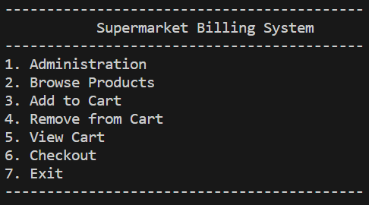
How does it Works?
It has a menu-driven interface that includes:
1. Administration
2. Browse Products
3. Add to Cart
4. Remove from Cart
5. View Cart
6. Checkout
7. Exit
*

Slide 4
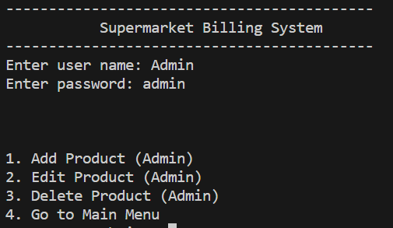
Administration
..
..
{
*
To enter into admin panel user have to login with username and password.
After successful logins there are:
1. Add Product (Admin)
2. Edit Product (Admin)
3. Delete Product (Admin)
4. Go to Main Menu
The user keeps logged in until he/she select the 4th option, Go to Main Menu.
}

Slide 5
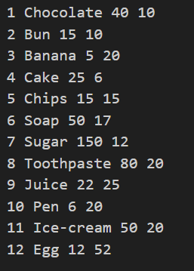
Product.txt
*
}
In Product.txt the action of product addition, edit and deletion happens.

Slide 6
Buyer’s Portion
From the browse product option buyer can have a list of products, it’s price and avaivle quantity. Based on that they can add or remove and also see products on their cart. After having their desire cart they can checkout and have a recipt of total bills.
Buyer’s get,
Browse Products
Add to Cart
Remove from Cart
View Cart
Checkout
Exit from the program.
}
..

Slide 7
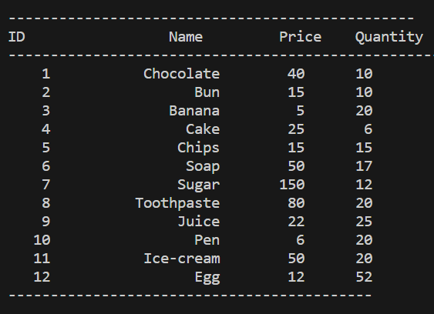
Browse Products
Browse products display a overall list of all avaiable products stored in product.txt with product id, name, unit price and avaiable quantity.
The quanti of product reduces when someone checked out them.
*

Slide 8


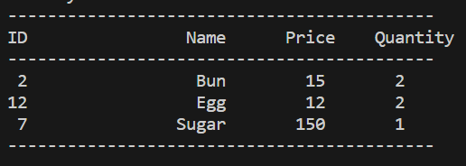
Controls on Cart
...
Add to cart
Remove from Cart
View Cart
..
..

Slide 9
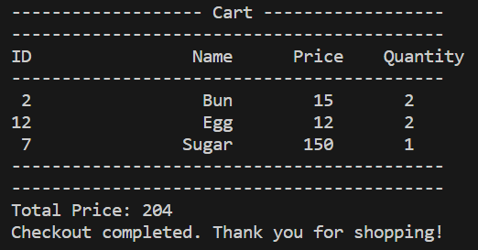
Checkout
{
On Checkout the program generates a printable invoice which includes products buyer have brought and the total amount of price.
..
}
..

Slide 10

Exit
{
Choosing exit simply exits from the program.
}

Slide 11
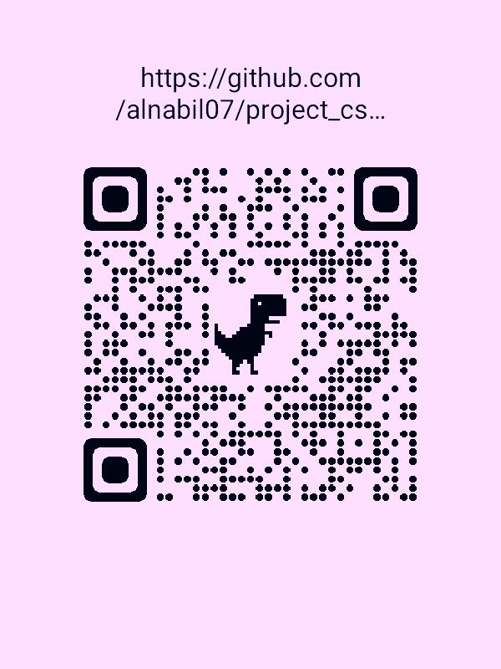
Source Code
{
By scanning the QR code you can see the code on GitHub or just simply use this URL:
https://github.com/alnabi107/project_cse_2188
}

Slide 12
Questions?
{
..
Any
}
..

Slide 13


..
..

